Slide 1

OLIST STORE ANALYSIS
By Group No. 06

Slide 2
CONTENTS
INTRODUCTION
OBJECTIVE AND OVERVIEW
DASHBOARD
INSIGHTS
STRATEGIC RECOMMENDATIONS

Slide 3
INTRODUCTION:
Olist is a Brazilian e-commerce platform that connects small and medium-sized businesses with customers across Brazil.
Olist acts as a marketplace, allowing businesses to list their products for sale online and for customers to browse and purchase them.

Slide 4
Project Overview and Objectives:
Objective:
To gain actionable insights into customer purchase behavior and satisfaction to support strategic decisions in enhancing customer experience.
Key Focus Areas:
Understand factors influencing customer satisfaction and delivery impact.
Assess purchase behaviors based on payment methods and geographic segmentation.

Slide 5
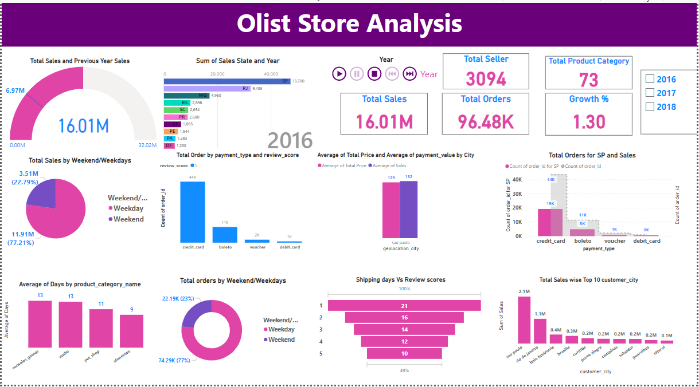
Power BI Dashboard:

Slide 6
INSIGHTS

Slide 7
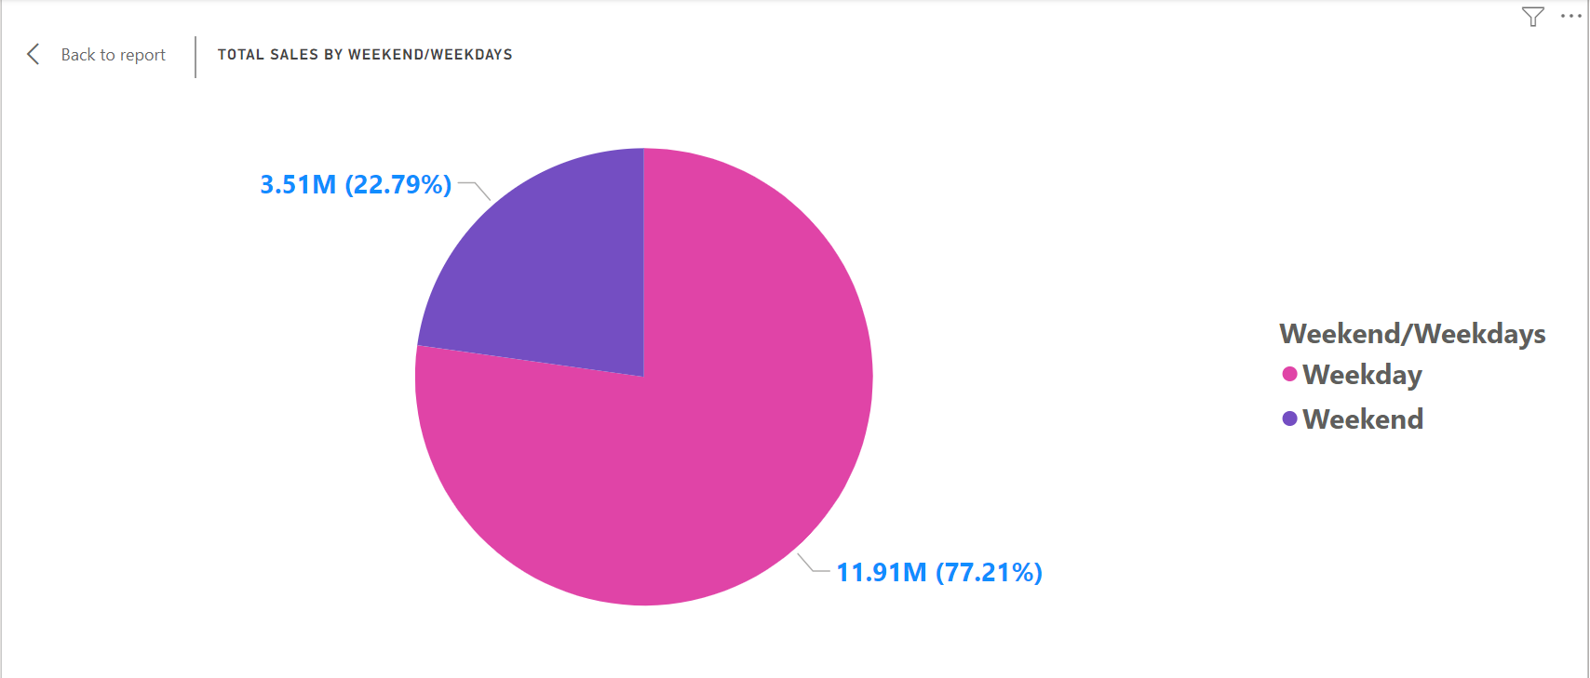
Order Behavior:
Weekdays vs. Weekends
Analysis reveals that weekdays see higher order volumes.
This trend indicates that customers are more active during weekdays, suggesting an opportunity for targeted promotions.

Slide 8
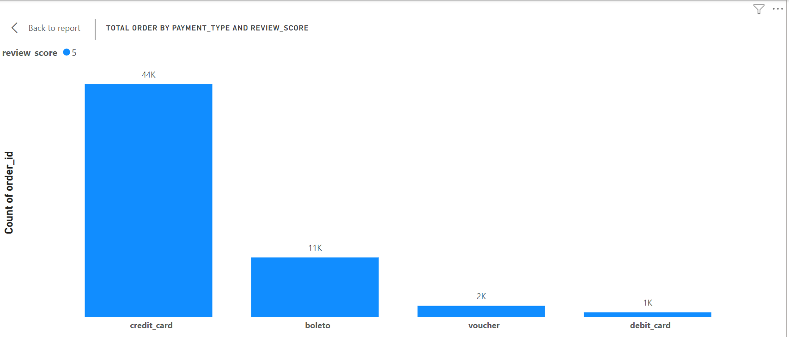
Payment Preferences:
Dominance of Credit Cards:
Credit cards are the preferred payment method, especially for 5-star reviews, followed by boleto.
This highlights the importance of secure and convenient payment options in driving customer satisfaction.

Slide 9
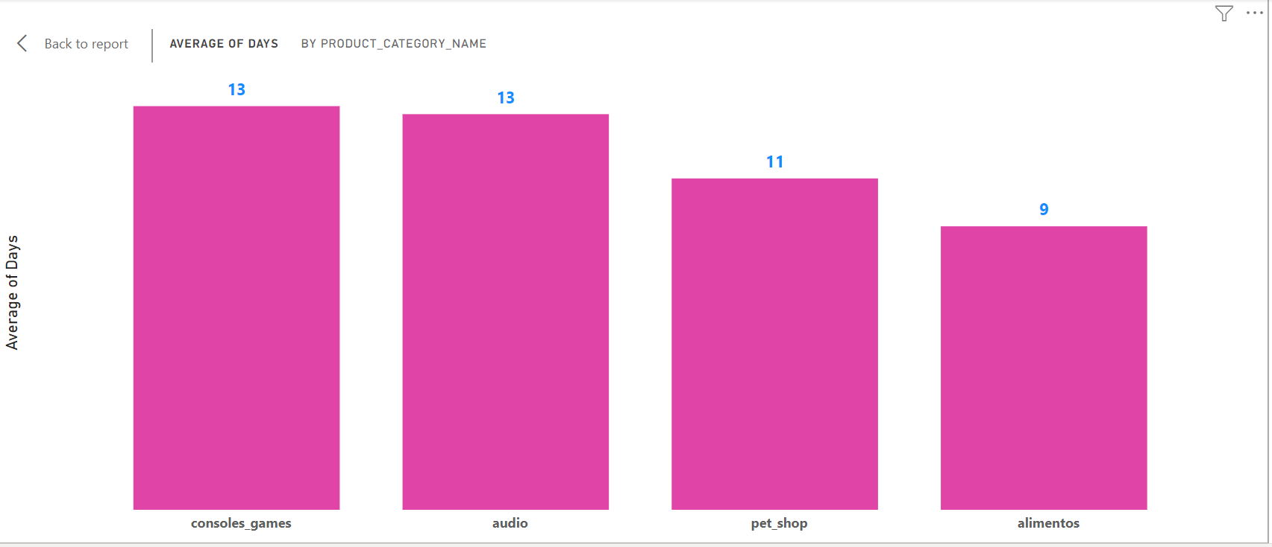
Delivery Times:
Category Variations:
On an average, the delivery of a product takes 12 days, with pet shop products averaging 11 days.
Making the delivery processes simpler for categories with longer times could enhance overall efficiency.

Slide 10
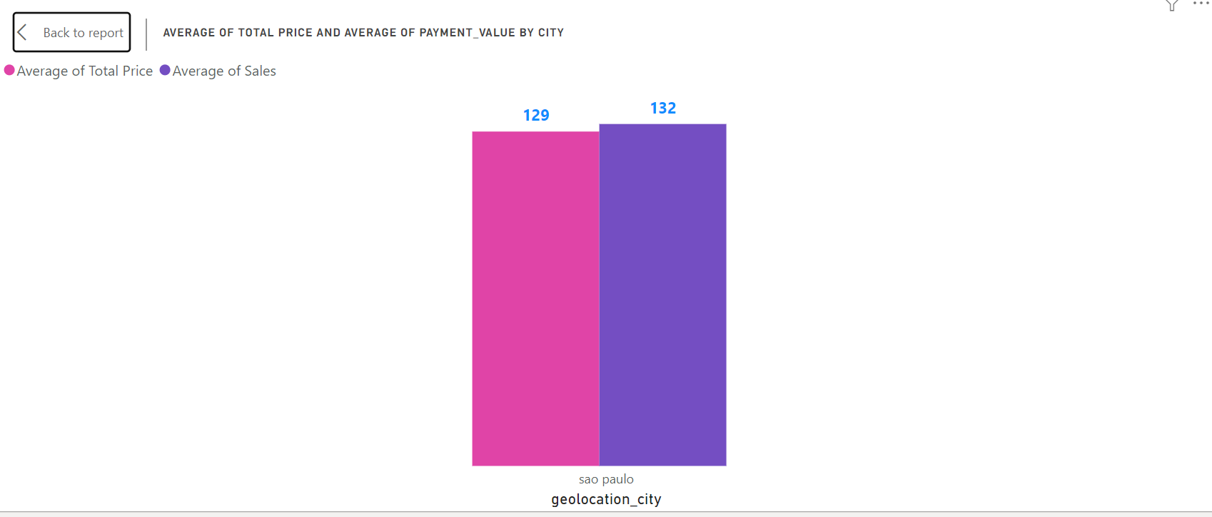
Geographical Insights:
City-wise Trends:
Sao Paulo records the highest order counts.
In Sao Paulo, the average payment surpasses the average price, likely due to high order density.
Customised marketing strategies for these regions could further boost sales.

Slide 11
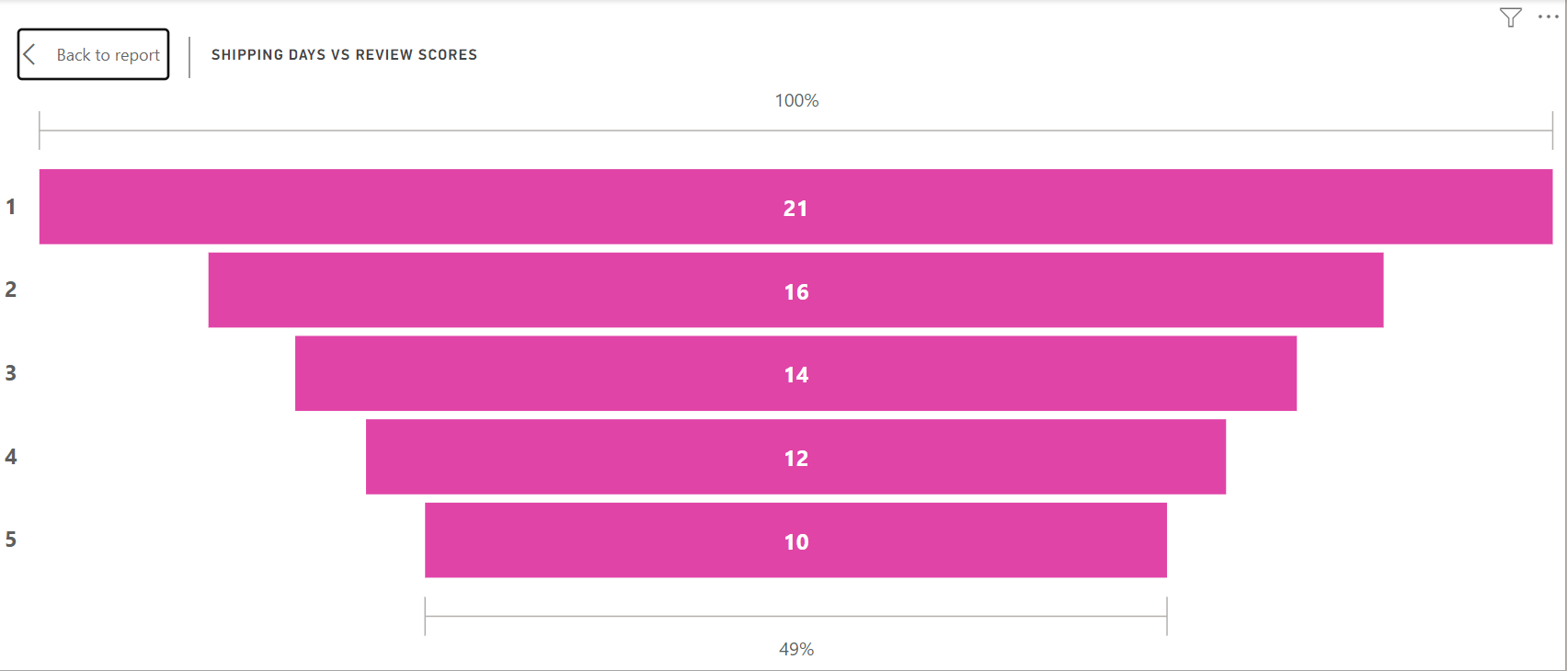
Shipping Duration and Reviews:
Negative Correlation:
A clear negative correlation exists between shipping duration and review scores.
Faster shipping times are associated with higher review scores, emphasizing the need for efficient logistics.

Slide 12
Strategic Recommendations:

Slide 13
Targeted Weekday Promotions:
The company can run advertisements on its website and introduce new offers as per demand, particularly on weekdays, to grab the attention of customers.
Localized Marketing Strategies:
Develop region-specific marketing campaigns for low-order cities, leveraging local insights to connect with customers more effectively.
Enhance Payment Security:
Prioritize measures to further secure credit card transactions, maintaining customer trust and encouraging repeat business.
Improve Shipping Efficiency:
Address shortcomings in the shipping process by enhancing warehouse workflows and forming strategic carrier partnerships to reduce delivery times.
Diversify Payment Options:
Expand payment options to include alternatives like debit cards and promote the use of boleto, catering to diverse customer preferences and expanding market reach.

Slide 14
THANK YOU

